Slide 1
School of Computing Science and Engineering
Course BTCS4801
Course Name: Research Methodology & IPR
Unit I: MEANING OF RESEARCH PROBLEM
.
Program Name: B.Tech
Dr Manikandan Thirumalaisamy

Slide 2
UNIT I MEANING OF RESEARCH PROBLEM
Topics to be covered
Meaning of research problem,
Sources of research problem,
Criteria Characteristics of a good research problem,
Errors in selecting a research problem, Scope and objectives of research problem.
Approaches of investigation of solutions for research problem, data collection, analysis, interpretation, Necessary instrumentations.

Slide 3
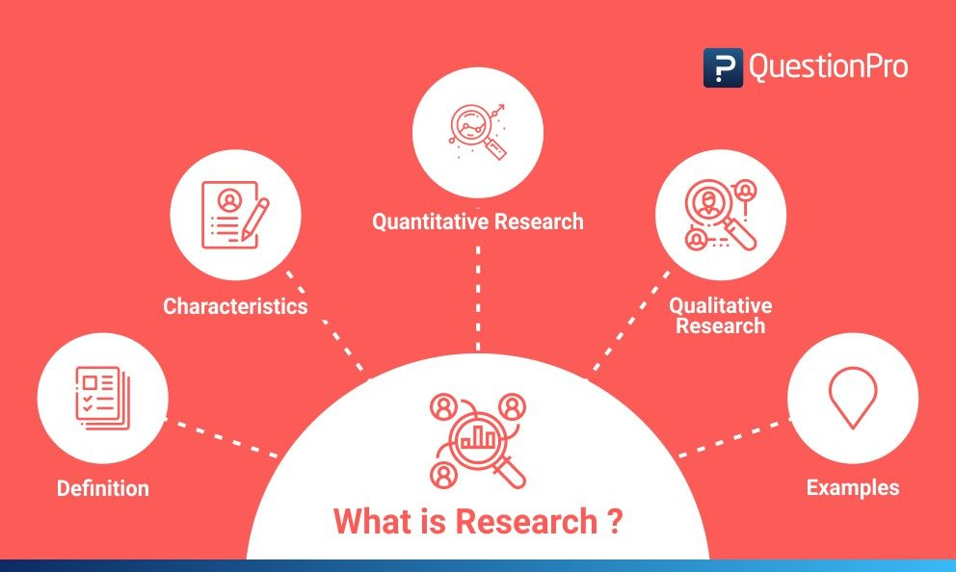
Research Methodology

Slide 4
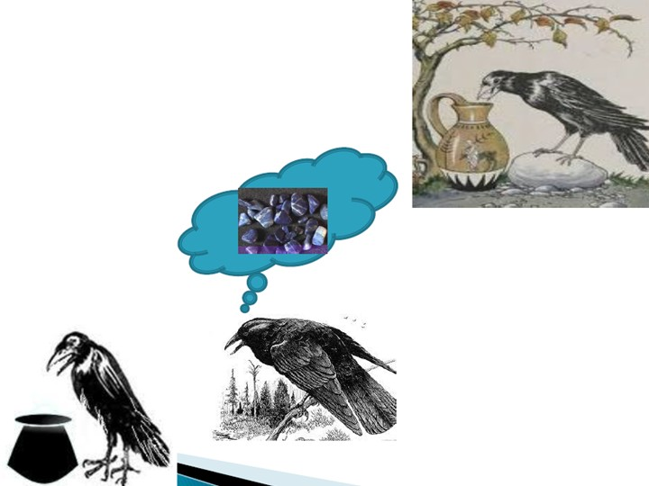
Research Methodology
Research methodology is the specific procedures or techniques used to identify, select, process, and analyze information about a topic. In a research paper, the methodology section allows the reader to critically evaluate a study’s overall validity and reliability.

Slide 5
INTRODUCTION
Meaning
Research is an endeavour to discover answers to intellectual and practical problems through the application of scientific method.
“Research is a systematized effort to gain new knowledge”.
-Redman and Mory.
Research is the systematic process of collecting and analyzing information (data) in order to increase our understanding of the phenomenon about which we are concerned orinenterested.
5

Slide 6
Characteristics of Research
Research is directed towards the solution of a problem.
Research is based upon observable experience or empirical evidence.
Research demands accurate observation and description.
Research involves gathering new data from primary sources or using existing data for a new purpose.
Research requires expertise i.e.,
skill necessary to carryout activities are characterized by carefully designed investigation.
6

Slide 7
Characteristics of Research
Research is objective and logical – applying every possible test to
validate the data collected and conclusions reached.
Research involves the quest for answers to unsolved problems.
Research requires courage.
Research is characterized by patient and unhurried activity.
Research is carefully recorded and report
7

Slide 8
Criteria Of a Good Research
Purpose clearly defined.
Research process detailed.
Research design thoroughly planned.
High ethical standards applied.
Limitations frankly revealed.
Adequate analysis for decision maker’s needs
Findings presented unambiguously.
Conclusions justified.
8

Slide 9
Criteria Of a Good Research
QUALITIES OF A GOOD RESEARCH
Systematic
Logical
Empirical
Replicable
NEED FOR RESEARCH
Exploration Describe Diagnose Hypothesis
Inductions and Deductions
9

Slide 10
Research Methodology
Definition: Research is defined as careful consideration of study regarding a particular concern or problem using scientific methods. According to the American sociologist Earl Robert Babbie, “research is a systematic inquiry to describe, explain, predict, and control the observed phenomenon. It involves inductive and deductive methods.”
Inductive research methods analyze an observed event, while deductive methods verify the observed event. Inductive approaches are associated with qualitative research, and deductive methods are more commonly associated with quantitative analysis.
Adapted from Figure 2-10 PMBOK Guide, 5th Edition

Slide 11
Research Methodology
Research is conducted with a purpose to:
Identify potential and new customers
Understand existing customers
Set pragmatic goals
Develop productive market strategies
Address business challenges
Put together a business expansion plan
Identify new business opportunities

Slide 12
Research Methodology
What are the characteristics of research?
Good research follows a systematic approach to capture accurate data. Researchers need to practice ethics and a code of conduct while making observations or drawing conclusions.
The analysis is based on logical reasoning and involves both inductive and deductive methods.
Real-time data and knowledge is derived from actual observations in natural settings.
There is an in-depth analysis of all data collected so that there are no anomalies associated with it.
It creates a path for generating new questions. Existing data helps create more research opportunities.
It is analytical and uses all the available data so that there is no ambiguity in inference.
Accuracy is one of the most critical aspects of research.

Slide 13
Purpose of Research
There are three main purposes:
Exploratory: As the name suggests, researchers conduct exploratory studies to explore a group of questions. The answers and analytics may not offer a conclusion to the perceived problem. It is undertaken to handle new problem areas that haven’t been explored before. This exploratory process lays the foundation for more conclusive data collection and analysis.

Slide 14
Purpose of Research
There are three main purposes:
Descriptive: It focuses on expanding knowledge on current issues through a process of data collection. Descriptive research describe the behavior of a sample population. Only one variable is required to conduct the study. The three primary purposes of descriptive studies are describing, explaining, and validating the findings. For example, a study conducted to know if top-level management leaders in the 21st century possess the moral right to receive a considerable sum of money from the company profit.

Slide 15
Purpose of Research
There are three main purposes:
Explanatory: Causal or explanatory research is conducted to understand the impact of specific changes in existing standard procedures. Running experiments is the most popular form. For example, a study that is conducted to understand the effect of rebranding on customer loyalty.

Slide 16
Research Methodology
Here is a comparative analysis for better understanding:
 | Exploratory Research | Descriptive Research | Explanatory Research
Approach used | Unstructured | Structured | Highly structured
Conducted through | Asking questions | Asking questions | By using hypotheses.
Time | Early stages of decision making | Later stages of decision making | Later stages of decision making

Slide 17

Research Methodology

Slide 18
Types of research methods and example
Research methods are broadly classified as Qualitative and Quantitative.
Both methods have distinctive properties and data collection methods.
Qualitative methods
Qualitative research is a method that collects data using conversational methods, usually open-ended questions. The responses collected are essentially non-numerical. This method helps a researcher understand what participants think and why they think in a particular way.

Slide 19
Types of research methods and example
Types of qualitative methods include:
One-to-one Interview
Focus Groups
Ethnographic studies
Text Analysis
Case Study

Slide 20
Types of research methods and example
Quantitative methods
Quantitative methods deal with numbers and measurable forms. It uses a systematic way of investigating events or data. It answers questions to justify relationships with measurable variables to either explain, predict, or control a phenomenon.
Types of quantitative methods include:
Survey research
Descriptive research
Correlational research
Remember, research is only valuable and useful when it is valid, accurate, and reliable. Incorrect results can lead to customer churn and a decrease in sales.

Slide 21
Types of research methods and example
It is essential to ensure that your data is:
Valid – founded, logical, rigorous, and impartial.
Accurate – free of errors and including required details.
Reliable – other people who investigate in the same way can produce similar results.
Timely – current and collected within an appropriate time frame.
Complete – includes all the data you need to support your business decisions.

Slide 22
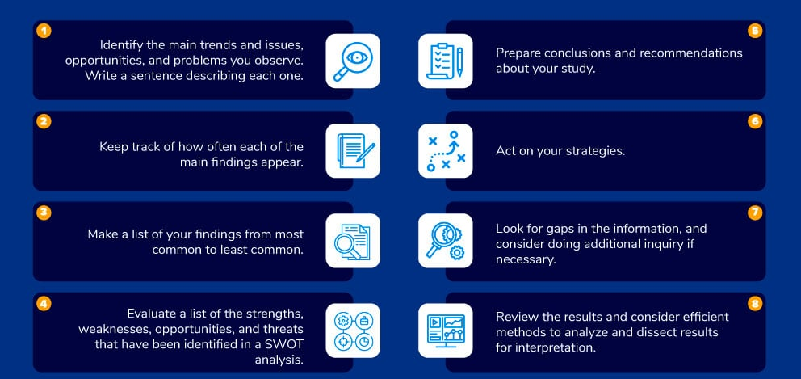
8 Tips for conducting accurate research

Slide 23
Definition of research problem
• “A problem is an interrogative sentence or statement that asks what relation exist between two or more variables. The answer to questions will provide what is having sought in the research.”
-Kerlinger.
“A situation for which we have no ready and successful response by instinct or by previous acquired habit. We must find out what to do ‘ i.e the solution can be found out only after an investigation”
-R.S.Woodworth.
23

Slide 24
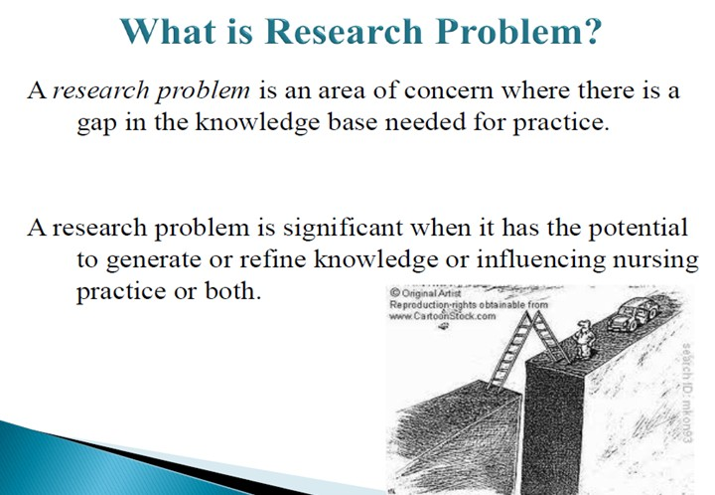
Research problem?
24

Slide 25
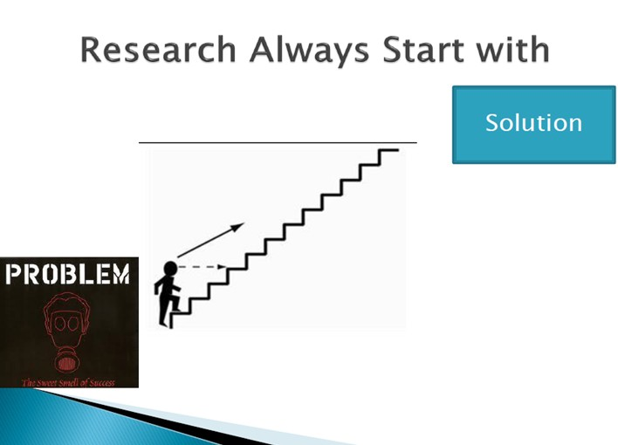
Identification of research problem
Identification of research problem Identification of a research problem is the first and most important step in research process generally a broad area is selected and then a board topic is delimited or narrowed down to specific one sentence statement of the problem.
25

Slide 26
Types of research Problem
There are four general conceptualizations of a research problem in the social sciences:
1. Casuist Research Problem -- this type of problem relates to the determination of right and wrong in questions of conduct or conscience by analyzing moral dilemmas through the application of general rules and the careful distinction of special cases.
2. Difference Research Problem -- typically asks the question, “Is there a difference between two or more groups or treatments?” This type of problem statement is used when the researcher compares or contrasts two or more phenomena. This a common approach to defining a problem in the clinical social sciences or behavioral sciences.
26

Slide 27
Types of research Problem
There are four general conceptualizations of a research problem in the social sciences:
3. Descriptive Research Problem -- typically asks the question, "what is...?" with the underlying purpose to describe the significance of a situation, state, or existence of a specific phenomenon. This problem is often associated with revealing hidden or understudied issues.
4. Relational Research Problem -- suggests a relationship of some sort between two or more variables to be investigated. The underlying purpose is to investigate specific qualities or characteristics that may be connected in some way.
27

Slide 28
Criteria Of a Good Research Problem
Clear and Unambiguous
Empirical
Verifiable
Interesting
Novel and Original
Availability of Guidance
28

Slide 29
Sources of Problems
Sources of research problem
1.Person experience
• Day-to-day personal experience of a researcher may serve as good source of ideas to formulate a research problem.
• For example, a researcher observed domestic violence suffered by wives of alcoholic husbands. This experience may provide ideas to identify several research problems related to domestic violence against women. There may be so many such life experiences of a researcher which could be used to develop a research problem.
29

Slide 30
Sources of Problems
•2. Practical experience:
• Nurses get plenty of ideas to formulate research problems from their clinical experiences. Every curious nurse has several questions to be answered that are encountered during clinical experience.
• For example, a nurse finds that unrestricted visiting hours in surgical wards reduced the analgesic demand among postoperative patients. In another instance, a nurse observed that application of ice at the site of heparin injection reduced the chances of ecchymosis. Such clinical experiences could be rich sources of ideas to identify a significant research problem.
30

Slide 31
Sources of Problems
• 3.Critical appraisal of literature:
• When we critically study books and articles relating to the subject of our interest, including research reports, opinion articles, and summaries of clinical issues, pertinent questions may arise in our mind. These may strike reader's mind indirectly by stimulating imagination and directly by stating what additional research is needed.
• For example, a nurse reads an article on the prevalence of the pin site infection among patients with external fixators
31

Slide 32
Sources of Problems
• 4.Previous research:
• A body of knowledge should be developed on a sound foundation of re- search findings. Usually, at the end of a research, further research problems are suggested, based on the shortcomings of previous research, which can be investigated. In nursing profession, not much research has been yet done; therefore, this profession needs researchers who are willing to replicate or repeat other studies on different samples and settings where all the essential elements of the original study are held intact. Further refinements may be made in the experimental treatments, or more appropriate outcome measures may be identified. •
32

Slide 33
Sources of Problems
5.Existing theories:
• Research is a process of theory development and theory testing. Nurses use many theories from other disciplines in their practices. If an existing theory is used in developing a researchable problem, a specific statement from the theory must be isolated. Generally, a part or parts of the theory are subjected to testing in the clinical situation. The testing of an existing theory is definitely needed in nursing; therefore, they serve as good sources of research problems.
33

Slide 34
Sources of Problems
6.Consumer feedback:
• Research problems may be generated from the results of activities aimed to solicit patient feedback. • For example, at the time of discharge of patient after angiography, a nurse obtained a feedback from the patient. Patient verbalized that it was a wonderful experience except discomfort during removal of pressure dressing at the oral puncture site.
This feedback provided a concept for nurse to research on efficacy available alternative means of dressing at puncture site to minimize the discomfort g patient undergoing angiography
34

Slide 35
Sources of Problems
7.Performance improvement activities:
• The performance improvement activities, also known as quality improvement activities, are used to improve processes and outcomes to meet regulatory requirement. In the process of performance activities, several issues merge that require answers through research.
Thus performance improvement activities also serve as an important source of research problem. •
35

Slide 36
Sources of Problems
•8.Social issues:
•Sometimes, topics are suggested by more global contemporary social or political issues of relevance to the health care community.
•For example, HIV/AIDS, female feticide, sexual harassment, domestic violence, and gender equality in health care and in research are some of the current social and political issues of concern for health care professionals. An idea for a study may stem from a familiarity with social concerns or controversial social issues.
36

Slide 37
Sources of Problems
•9.Brainstorming:
• Brainstorming sessions are good techniques to find new questions, where an intensified discussion among interested people of the profession is conducted to find more ideas to formulate a good research problem.
• For example, ideas for studies may emerge from reviewing research priorities by having brainstorming session with other nurses, researchers, or nursing faculty
37

Slide 38
Sources of Problems
•10.Intuition:
• Traditionally, intuitions are considered good sources of knowledge as well as sources to find new research problems. It is believed that the reflective mind is a good source of ideas, which may be used to formulate a good research problem
38

Slide 39
Sources of Problems
11.Folklores:
Common beliefs could be right or wrong. For example, it is generally believed that studying just before the test decreases the score. We believe we should not study just before test to relax our mind.
Researchers can conduct a research study on whether one should study before the test or not.
39

Slide 40
Sources of Problems
12.Exposure to field situations: During field exposure, researchers get variety of experiences, which may provide plenty of ideas to formulate research problems. For example, while working in field, a researcher observed a specific traditional practice for cure of a disease condition, which can be used as research problem to investigate its efficacy
13. Consultations with experts: Experts are believed to have sound experience of their respective field, which may suggest a significant problem to be studied. In addition, experts may help in finding a current problem of discipline to be solved, which may serve as basis for formulation of research problem.
40

Slide 41
Characteristics of research Problem
Feasible
• Adequate number of subjects
• Adequate technical expertise
• Affordable in time and money
• Manageable in scope
Interesting
• Getting the answer intrigues the investigator and her friends
Novel
• Confirms, refutes or extends previous findings
• Provides new findings
Ethical
Amenable to a study that institutional review board will approve
Relevant
• To scientific knowledge
• To clinical and health policy
• To future research
41

Slide 42
Criteria of a Good Research Problem.
Criteria of a Good R.P.
• Novelty
• Interesting
• Importance
• Feasibility
• Availability of data
• Availability of cooperation
• Availability of guidance
• Availability of other facilities
• Applicability
• Level of Research
• Experience & creativity
• Courage & confidence
42

Slide 43
Problems In Research
Not similar to science
Uncontrollable variables
Human tendencies
Time and money
Lack of computerization
Lack of scientific training in the methodology of Research
Insufficient interaction between university research departments and business establishments
43

Slide 44
Problems In Research
Lack of confidence on the part of business units to give information
Lack of code of conduct
Difficulty of adequate and timely secretarial assistance
Poor library management and functioning
Difficulty of timely availability of published data.
Ignorance
Research for the sake of research-limited practical utility though they may use high sounding business jargon.
44

Slide 45
Errors in selecting a research problem,
Common errors in selecting & formulating a Research problem
1. Naming a broad field/area of the study instead of a specific problem.
2. Stating it in such a way that investigation is impossible
3. Narrowing/localizing a topic
4. Including in it terms of an unscientific, emotional or biased nature
5. Lack of precision in the instruments
Don’t
• Choose subject/topic overdone, difficult to throw new light in such a case
• Controversial problem
• Too narrow or too vague
• Over costly
• Time limit
45

Slide 46
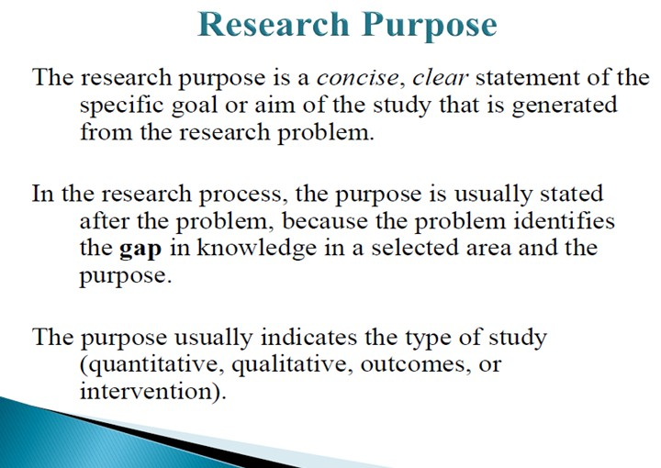
Research Purpose
46

Slide 47
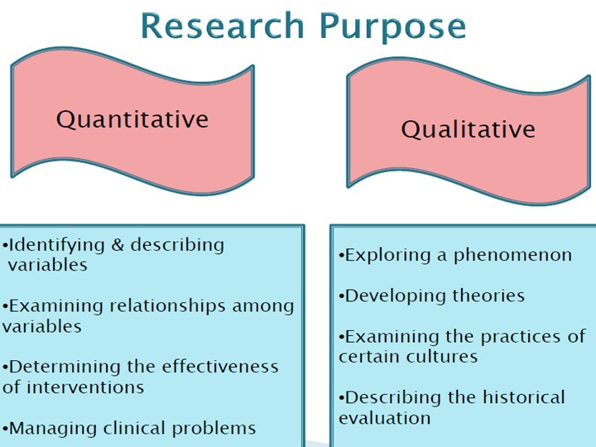
Research Purpose
47

Slide 48
Research Objectives,
Objectives: What the researcher wants to get.
To gain familiarity with a phenomenon or to achieve new insights into it
To portray accurately the characteristics of a particular individual, situation or a group
To determine the frequency with which something occurs or with which it is associated with something else.
To test a hypothesis of a causal relations between variables.
Scope: The opportunity or possibility to do or deal with something.
Significance: the quality of being worthy of attention; importance.
48

Slide 49
Research Approach
Research Approach
In the field of science different researchers may assign different meanings for the team research approach. In some publications you may see that research approach may imply methods of data collection and data analysis in general and differences between qualitative and quantitative methods in particular.
However, in our view research approach is best seen as a general plan and procedure for conducting the study. Accordingly, approach for the research can be divided into three categories:
Deductive approach
Inductive approach
Abductive approach
49

Slide 50
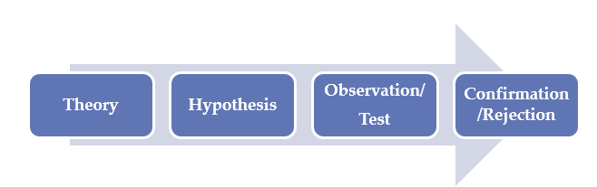
Research Approach
Deductive Approach
If you have formulated a set of hypotheses for your dissertation that need to be confirmed or rejected during the research process you would be following a deductive approach.
In deductive approach, the effects of labour migration within the EU are assessed by developing hypotheses that are tested during the research process.
50

Slide 51
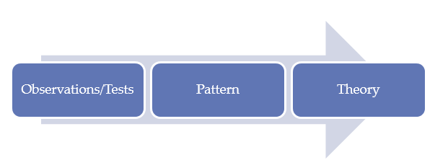
Research Approach
Inductive Approach
Alternatively, inductive approach does not involve formulation of hypotheses. It starts with research questions and aims and objectives that need to be achieved during the research process.
Inductive studies follow the route below:
51

Slide 52
Research Approach
Abductive Approach
In abductive approach, the research process is devoted to explanation of ‘incomplete observations’, ‘surprising facts’ or ‘puzzles’ specified at the beginning of the study. Referring to the same research topic, you may observe that labour migration within the EU was actually decreasing the extent of cross-cultural differences within teams in Dutch private sector organizations.
52

Slide 53
Data Collection
Data are special type of information, generally obtained through observation, surveys, enquiries, or are generated as a result of human activity for the purpose of research.
The data collection technique is different for different types of research design. There are predominantly two types of data:
Primary data
Primary data is the kind of data that is collected directly from the data source without going through any existing sources.
It is mostly collected specially for a research project and may be shared publicly to be used for other research
Secondary data
Secondary data is the data that has been collected in the past by someone else but made available for others to use.
They are usually once primary data but become secondary when used by a third party.
53

Slide 54
Data Collection – Source of methods
Primary data sources include;
Surveys,
observations,
questionnaires,
interviews,
Case Study, etc.,
Secondary data sources include;
books,
journals,
articles,
web pages,
blogs, etc.
54

Slide 55
Data Collection – Source of methods
1. Surveys,
One of the common methods of diagnosing and solving of social problems are that of undertaking surveys.
Surveys are….
1. A detailed inspection or investigation.
2. A general or comprehensive view.
3. A gathering of a sample of data or opinions considered to be representative of a whole.
In the words of Festinger and Kat, “Many research problems require systematic collection of data from population through the use of personal interviews or other data gathering devices.
55

Slide 56
Data Collection – Source of methods
Types of Surveys,
General or Specific survey
Census or sample survey
Public opinion surveys
Private surveys
Confidential survey
Postal survey
Pilot or main survey
56

Slide 57
Data Collection – Source / methods
2. OBSERVATION METHOD:
Observation method is a method under which data from the field is collected with the help of observation by the observer or by personally going to the field. No conversation or communication should be done while observing.
In the words of P.V. Young, “Observation may be defined as systematic viewing, coupled with consideration of seen phenomenon.”
Types of Observations:
A)-Structured and Unstructured Observation.
B)-Participant and Non Participant Observation.
C)-Controlled and Uncontrolled Observation
57

Slide 58
Data Collection – Source / methods
3. QUESTIONNAIRE METHOD: This is a set of questions arranged logically, divided into groups, with the object of collecting information for research. The questionnaire is mailed to respondents who are expected to read and understand the questions and write down the reply in the space meant for the purpose in the questionnaire itself or either chooses the reply among all choices available on closed end questionnaire.
VARIOUS FORMS OF QUESTIONS USED IN QUESTIONNAIRE:
A) Direct Question and Indirect Question
B) Open Form of Questions and Closed -end Form of Questions
C) Dual-choice Questions or Multiple Choice Questions (MCQ), and Scale or Rating Questions .
58

Slide 59
Data Collection – Source / methods
4. INTERVIEW METHOD: This method of collecting data involves presentation or oral-verbal stimuli and reply in terms of oral-verbal responses. Conversation and communication is the main tool of interview.
Types of Interviews:
A) Personal interviews B) Telephonic interviews
C) Structured interviews D) Unstructured interviews
E) Focused interviews F) In-Depth interviews.
59

Slide 60
Data Collection – Source / methods
5) CASE STUDY METHOD: It is an appropriate tool of data collection in studying a individual a family a institution or group behavior in detail. It is essentially an intensive investigation of the particular unit under consideration.
Its important characteristics are as follows:
a) The researcher can take one single social unit or more of such units for his study purpose.
b) The selected unit is studied intensively i.e. it is studied in minute details.
c) The behavior pattern of the concerning unit is studied.
60

Slide 61
Data Collection – Source / methods
METHODS/SOURCES OF SECONDARY DATA COLLECTION:-
Secondary data are available mainly in two forms- published data and unpublished data:-
PUBLISHED DATA: Published data are more often the information required by individuals and organizations is published in some form or the other in consideration of user’s need. It can used in annexure too.
For e.g. the companies publish their financial statements in the form of quarterly or half yearly or annual reports.
UNPUBLISHED DATA: - Unpublished data are that secondary information which is available from records which are not published due to privacy or variety of reasons.
For e.g. works of scholars, research workers, trade associations etc.
61

Slide 62
Data Collection – Source / methods
Secondary Source can be divided in to two forms:
1)-PERSONAL/PRIVATE RECORDS OR DOCUMENTS-
This documents denotes individual‘s feelings, opinions and an idea about different socio-cultural changes, social incidents and structural changes. These records can be in both published and unpublished form.
A)-Letters,
B)-Personal diaries,
C)-Autobiography and memories.
D)-Enquiries or investigation of private nature for use of their members only.
62

Slide 63
Data Collection – Source / methods
Secondary Source can be divided in to two forms:
2)-PUBLIC DOCUMENTS OR RECORDS- Public documents play a vital role in secondary source of data collection.
Various types of unpublished and published data are collected by government on nongovernment agencies. These public documents/records are…..
A)-Publications of Central, state, local government.
B)-Technical and trade journals.
C)-Books, Magazines, Newspaper …..
D)-Reports & publications of industry, bank, stock exchange.
E)-Reports by research scholars, Universities, economists.
F)-Association or census reports, reports of international org. (UNESCO, WHO, ILO etc).
G)-Official records.
H)-Historical records.
63

Slide 64
Data Collection –Source / Methods
Both types of data offer specific advantages and disadvantages.
Secondary data offer cost and time economies to the researcher as they already exist in various forms in the company or in the market.
It is feasible for a firm to collect.
Since they are collected for some other purposes, it may sometimes not fit perfectly into the problem defined. d) The objectives, nature and methods used to collect the secondary data may not be appropriate to the present situation.
64

Slide 65
Data Analysis
Data analysis is defined as a process of cleaning, transforming, and modeling data to discover useful information for business decision-making.
The purpose of Data Analysis is to extract useful information from data and taking the decision based upon the data analysis.
Types of Data Analysis are Text, Statistical, Diagnostic, Predictive, Prescriptive Analysis
Data Analysis consists of Data Requirement Gathering, Data Collection, Data Cleaning, Data Analysis, Data Interpretation, Data Visualization
65

Slide 66

Data Analysis
Data Analysis Tools
Data analysis tools make it easier for users to process and manipulate data, analyze the relationships and correlations between data sets, and it also helps to identify patterns and trends for interpretation. Here is a complete list of tools used for data analysis in research.
66

Slide 67
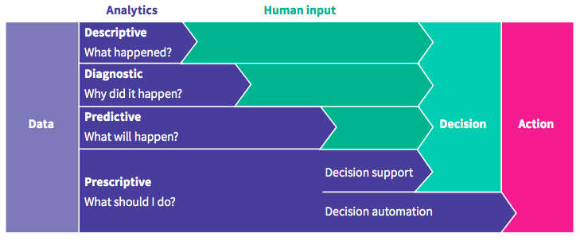
Types of Data Analysis: Techniques and Methods
Types of Data Analysis: Techniques and Methods
There are several types of Data Analysis techniques that exist based on business and technology. However, the major Data Analysis methods are:
Text Analysis
Statistical Analysis
Diagnostic Analysis
Predictive Analysis
Prescriptive Analysis
67

Slide 68
Types of Data Analysis: Techniques and Methods
1. Text Analysis
Text Analysis is also referred to as Data Mining. It is one of the methods of data analysis to discover a pattern in large data sets using databases or data mining tools.
It used to transform raw data into business information.
Business Intelligence tools are present in the market which is used to take strategic business decisions. Overall it offers a way to extract and examine data and deriving patterns and finally interpretation of the data.
68

Slide 69
Types of Data Analysis: Techniques and Methods
2. Statistical Analysis
Statistical Analysis shows “What happen?” by using past data in the form of dashboards. Statistical Analysis includes collection, Analysis, interpretation, presentation, and modeling of data. It analyses a set of data or a sample of data.
There are two categories of this type of Analysis – Descriptive Analysis and Inferential Analysis
2.1 Descriptive Analysis
analyses complete data or a sample of summarized numerical data. It shows mean and deviation for continuous data whereas percentage and frequency for categorical data.
2.2 Inferential Analysis
analyses sample from complete data. In this type of Analysis, you can find different conclusions from the same data by selecting different samples.
69

Slide 70
Types of Data Analysis: Techniques and Methods
3. Diagnostic Analysis
Diagnostic Analysis shows “Why did it happen?” by finding the cause from the insight found in Statistical Analysis. This Analysis is useful to identify behavior patterns of data. If a new problem arrives in your business process, then you can look into this Analysis to find similar patterns of that problem. And it may have chances to use similar prescriptions for the new problems.
70

Slide 71
Types of Data Analysis: Techniques and Methods
4. Predictive Analysis
Predictive Analysis shows “what is likely to happen” by using previous data. The simplest data analysis example is like if last year I bought two dresses based on my savings and if this year my salary is increasing double then I can buy four dresses. But of course it’s not easy like this because you have to think about other circumstances like chances of prices of clothes is increased this year or maybe instead of dresses you want to buy a new bike, or you need to buy a house!
So here, this Analysis makes predictions about future outcomes based on current or past data. Forecasting is just an estimate. Its accuracy is based on how much detailed information you have and how much you dig in it.
71

Slide 72
Types of Data Analysis: Techniques and Methods
5. Prescriptive Analysis
Prescriptive Analysis combines the insight from all previous Analysis to determine which action to take in a current problem or decision. Most data-driven companies are utilizing Prescriptive Analysis because predictive and descriptive Analysis are not enough to improve data performance. Based on current situations and problems, they analyze the data and make decisions.
72

Slide 73
Data Analysis Process
A researcher's important function is the appropriate interpretation of different types of statistical data with the help of his tools.
The preliminary statistical work consists of
collection,
classification,
tabulation,
presentation
analysis of data.
73

Slide 74
Data Analysis Process
The Data Analysis Process is nothing but gathering information by using a proper application or tool which allows you to explore the data and find a pattern in it. Based on that information and data, you can make decisions, or you can get ultimate conclusions.
Data Analysis consists of the following phases:
Data Requirement Gathering
Data Collection
Data Cleaning
Data Analysis
Data Interpretation
Data Visualization
74

Slide 75
Data Analysis Process
1. Data Requirement Gathering
First of all, you have to think about why do you want to do this data analysis? All you need to find out the purpose or aim of doing the Analysis of data. You have to decide which type of data analysis you wanted to do! In this phase, you have to decide what to analyze and how to measure it, you have to understand why you are investigating and what measures you have to use to do this Analysis.
2. Data Collection
After requirement gathering, you will get a clear idea about what things you have to measure and what should be your findings. Now it’s time to collect your data based on requirements. Once you collect your data, remember that the collected data must be processed or organized for Analysis. As you collected data from various sources, you must have to keep a log with a collection date and source of the data.
75

Slide 76
Data Analysis Process
3. Data Cleaning
Now whatever data is collected may not be useful or irrelevant to your aim of Analysis, hence it should be cleaned. The data which is collected may contain duplicate records, white spaces or errors. The data should be cleaned and error free. This phase must be done before Analysis because based on data cleaning, your output of Analysis will be closer to your expected outcome.
4. Data Analysis
Once the data is collected, cleaned, and processed, it is ready for Analysis. As you manipulate data, you may find you have the exact information you need, or you might need to collect more data. During this phase, you can use data analysis tools and software which will help you to understand, interpret, and derive conclusions based on the requirements.
76

Slide 77
Data Analysis Process
5. Data Interpretation
After analyzing your data, it’s finally time to interpret your results. You can choose the way to express or communicate your data analysis either you can use simply in words or maybe a table or chart. Then use the results of your data analysis process to decide your best course of action.
6. Data Visualization
Data visualization is very common in your day to day life; they often appear in the form of charts and graphs. In other words, data shown graphically so that it will be easier for the human brain to understand and process it. Data visualization often used to discover unknown facts and trends. By observing relationships and comparing datasets, you can find a way to find out meaningful information.
77

Slide 78
Considerations/issues in data analysis
There are a number of issues that researchers should be cognizant of with respect to data analysis. These include:
Having the necessary skills to analyze
Concurrently selecting data collection methods and appropriate analysis
Drawing unbiased inference
Inappropriate subgroup analysis
Following acceptable norms for disciplines
Determining statistical significance
Lack of clearly defined and objective outcome measurements
Providing honest and accurate analysis
Manner of presenting data
Environmental/contextual issues
Data recording method
Partitioning ‘text’ when analyzing qualitative data
Training of staff conducting analyses
Reliability and Validity
Extent of analysis
78

Slide 79
Data Interpretation
Data Interpretation as the process of assigning meaning to the collected information and determining the conclusions, significance, and implications of the findings.
In other words, it's giving meaning to the collected 'cleaned' raw data.
Steps Of Data Interpretation
Data interpretation is conducted in 4 steps:
Assembling the information, you need (like bar graphs and pie charts);
Developing findings or isolating the most relevant inputs;
Developing conclusions;
Coming up with recommendations or actionable solutions.
79

Slide 80
Data Interpretation
Data Interpretation Methods
Data analysts or data analytics tools help people make sense of the numerical data that has been aggregated, transformed, and displayed.
There are two main methods for data interpretation:
Quantitative and
Qualitative.
80

Slide 81
Data Interpretation
Qualitative Data Interpretation Method
This is a method for breaking down or analyzing so-called qualitative data, also known as categorical data. It is important to note that no bar graphs or line charts are used in this method. Instead, they rely on text. Because qualitative data is collected through person-to-person techniques, it isn't easy to present using a numerical approach.
Surveys are used to collect data because they allow you to assign numerical values to answers, making them easier to analyze. If we rely solely on the text, it would be a time-consuming and error-prone process. This is why it must be transformed.
81

Slide 82
Data Interpretation
Quantitative Data Interpretation Method
This data interpretation is applied when we are dealing with quantitative or numerical data. Since we are dealing with numbers, the values can be displayed in a bar chart or pie chart. There are two main types: Discrete and Continuous. Moreover, numbers are easier to analyze since they involve statistical modeling techniques like mean and standard deviation.
Mean is an average value of a particular data set obtained or calculated by dividing the sum of the values within that data set by the number of values within that same set.
Standard Deviation is a technique is used to ascertain how responses align with or deviate from the average value or mean. It relies on the meaning to describe the consistency of the replies within a particular data set. You can use this when calculating the average pay for a certain profession and then displaying the upper and lower values in the data set.
82

Slide 83
Data Interpretation
Quantitative Data Interpretation Method
3.Standard deviation: This technique is used to measure how well the responses align with or deviates from the mean. It describes the degree of consistency within the responses; together with the mean, it provides insight into data sets.
4.Frequency distribution
This technique is used to assess the demography of the respondents or the number of times a particular response appears in research. It is extremely keen on determining the degree of intersection between data points.
Some other interpretation processes of quantitative data include:
Regression analysis
Cohort analysis
Predictive and prescriptive analysis
83

Slide 84
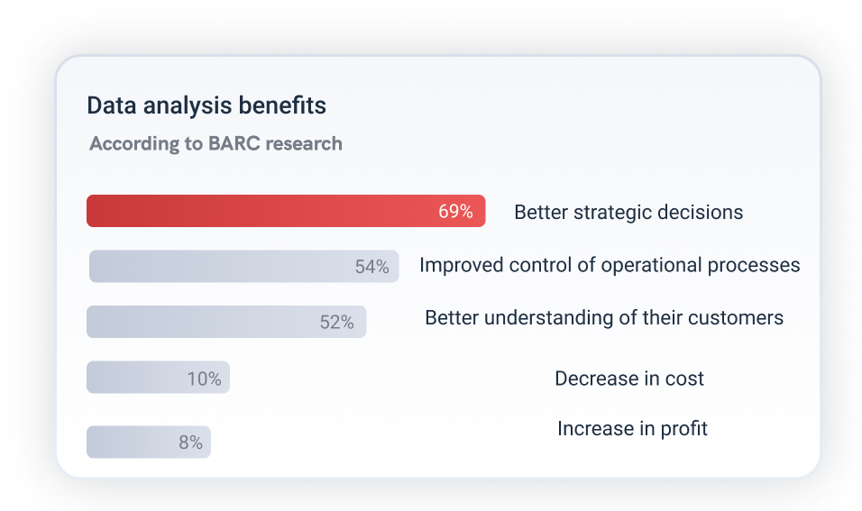
Data Interpretation
84

Slide 85
Data Visualization
Visualization Techniques in Data Analysis
One of the best practices of data interpretation is the visualization of the dataset. Visualization makes it easy for a layman to understand the data, and also encourages people to view the data, as it provides a visually appealing summary of the data.
There are different techniques of data visualization, some of which are highlighted below.
Bar Graphs
Grouped Bar Graph
Stacked Bar Graph
Segmented Bar Graph
Tables
Simple Tables
Complex Tables
Line Graph
Simple Line Graphs
Line Graphs with Markers
Stacked Line Graphs
Pie Chart
Simple Pie Chart
Doughnut Pie Chart
3D Pie Chart
85

Slide 86
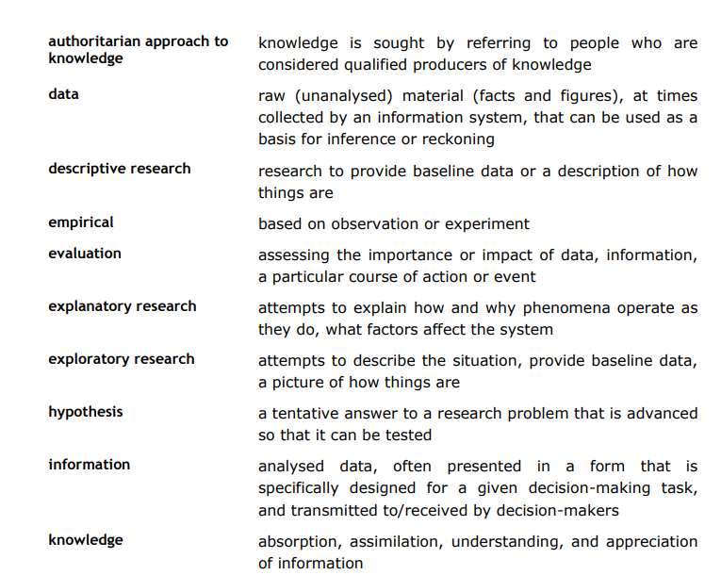
Key Term and Concepts
86

Slide 87
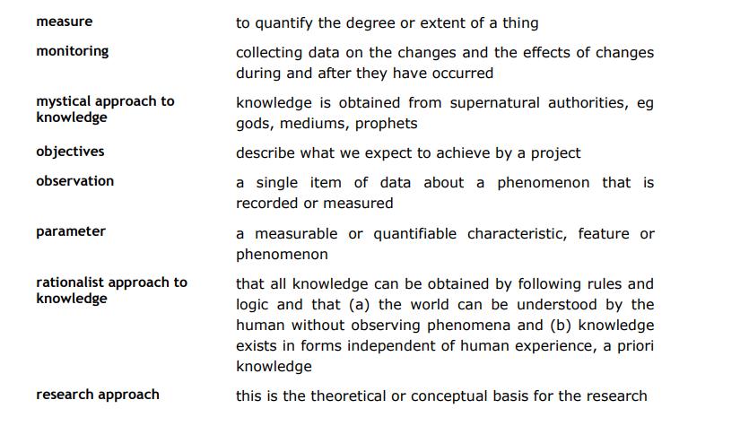
Key Term and Concepts
87

Slide 88
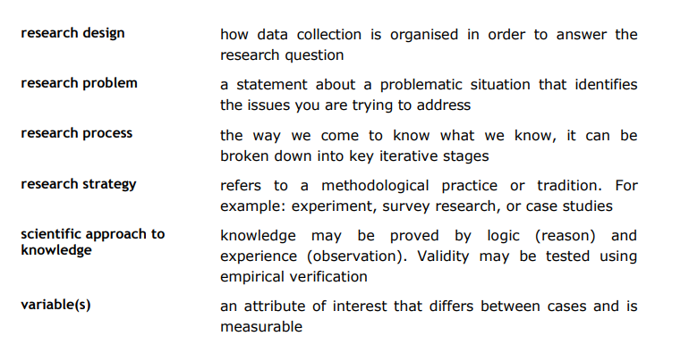
Key Term and Concepts
88

